Slide 1

AETEC / DSO NATIONAL LABORATORIES
Nomex automation: four quotations
One proposed line. Separate assembly and cutting workstreams, each with a POC entry route.
Quotation | Stage | Budget SGD | Included outcome | Options / scope boundary
Q912226010A Honeycomb assembly | POC | 326,000 | Handling, insertion, vision and glue trials. Prototype rigs and feasibility report. | 12–16 weeks. Lab equipment use only. Production machine excluded.
Q912226011A Upstream die cutting | POC | 168,000 | Sheet feed, trial dies, waste release, inspection and mock loading handoff. | 10–14 weeks. Preliminary cutting scope. Press supply excluded.
Q912226009J Honeycomb assembly | Complete project | 936,000 | ABB PoWa 20 cell, fixture, vision, drip and spray, controls and installation. | 40–48 weeks including POC. Production platen / vibration costs extra.
Q912226012A Upstream die cutting | Complete project | 450,000 | New cutting station, feed, waste release, vision and assembly-loading transfer. | 32–40 weeks including POC. Roll feed / existing-press retrofit excluded.
Both POCs: SGD 494,000
Complete systems: SGD 1,386,000
Route references, not additive. Reconcile accepted reusable POC work before the remaining-work quotation.
Management review • 19 October 2026 • Budgetary prices exclude GST
01
Notes:
Sources: Q912226010A_Nomex_Phase_1_POC_Quotation.pdf pp.3,7–10 (current PDF price SGD326,000); Q912226011A_Nomex_Upstream_Die_Cutting_Quotation.pdf pp.3–8 (SGD168,000); Q912226009J_Nomex_Robotic_Honeycomb_Assembly_Quotation.pdf pp.3,6–10 (SGD936,000); Q912226012A_Nomex_Complete_Upstream_Die_Cutting_System_Quotation.pdf pp.3–8 (SGD450,000). All quotations dated3 October2026. Totals:326,000+168,000=494,000;936,000+450,000=1,386,000. These totals are separate route references, not cumulative orders or guaranteed phased prices. Shared POC interface work is reconciled if both are ordered. Production estimates include their initial POCs and depend on approved inputs, trials, suppliers and release gates. Refer to original quotations for full scope, validity and terms.

Slide 2
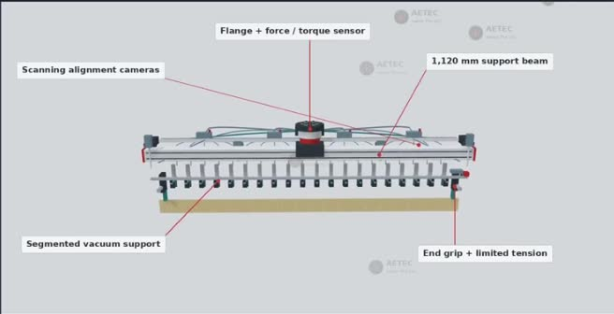
AETEC / DSO NATIONAL LABORATORIES
Honeycomb assembly POC
Q912226010A
SGD 326,000
12–16 weeks after approved inputs and samples
Handling and insertion
Supported vacuum / jaw gripper, spring-tension fixture, short strips, 5 × 5 grids and full-width trials.
Vision and adhesive testing
Camera alignment, post-placement checks, intersection drip, spray and a moving cover segment.
Supported-strip handling concept from the project video
Measured development campaign
What management receives
300 pickup attempts, 30 full-width insertions and up to 3 combined tooling refinement cycles.
Prototype records, trial evidence, feasibility report and a revised production recommendation.
Included: POC-scale platen / vibration screening.
Excluded: production robot, full machine and site SAT.
Management review • 19 October 2026 • Budgetary prices exclude GST
02
Notes:
Source: Q912226010A PDF, pp.3–10. Price326,000 supersedes earlier draft amounts. Two representative lots, three non-condensing handling conditions, one grade/thickness and one A/B pattern. The full-width setup is a sparse nominal1m 21-slot rig, not a complete1m² production panel. Trials are attempts, not guaranteed successes. Three combined refinement cycles apply across gripper/fixture campaign. Drip and spray use two formulations total, one per mode. Paid dedicated prototype parts/drawings may be handed over. General-purpose lab robots/cameras remain AETEC property. Unlisted work is excluded unless separately scoped, priced and approved. Image: user-provided VIDEO-2026-10-05-17-36-10.mp4, approximately01:59, existing engineering concept.

Slide 3
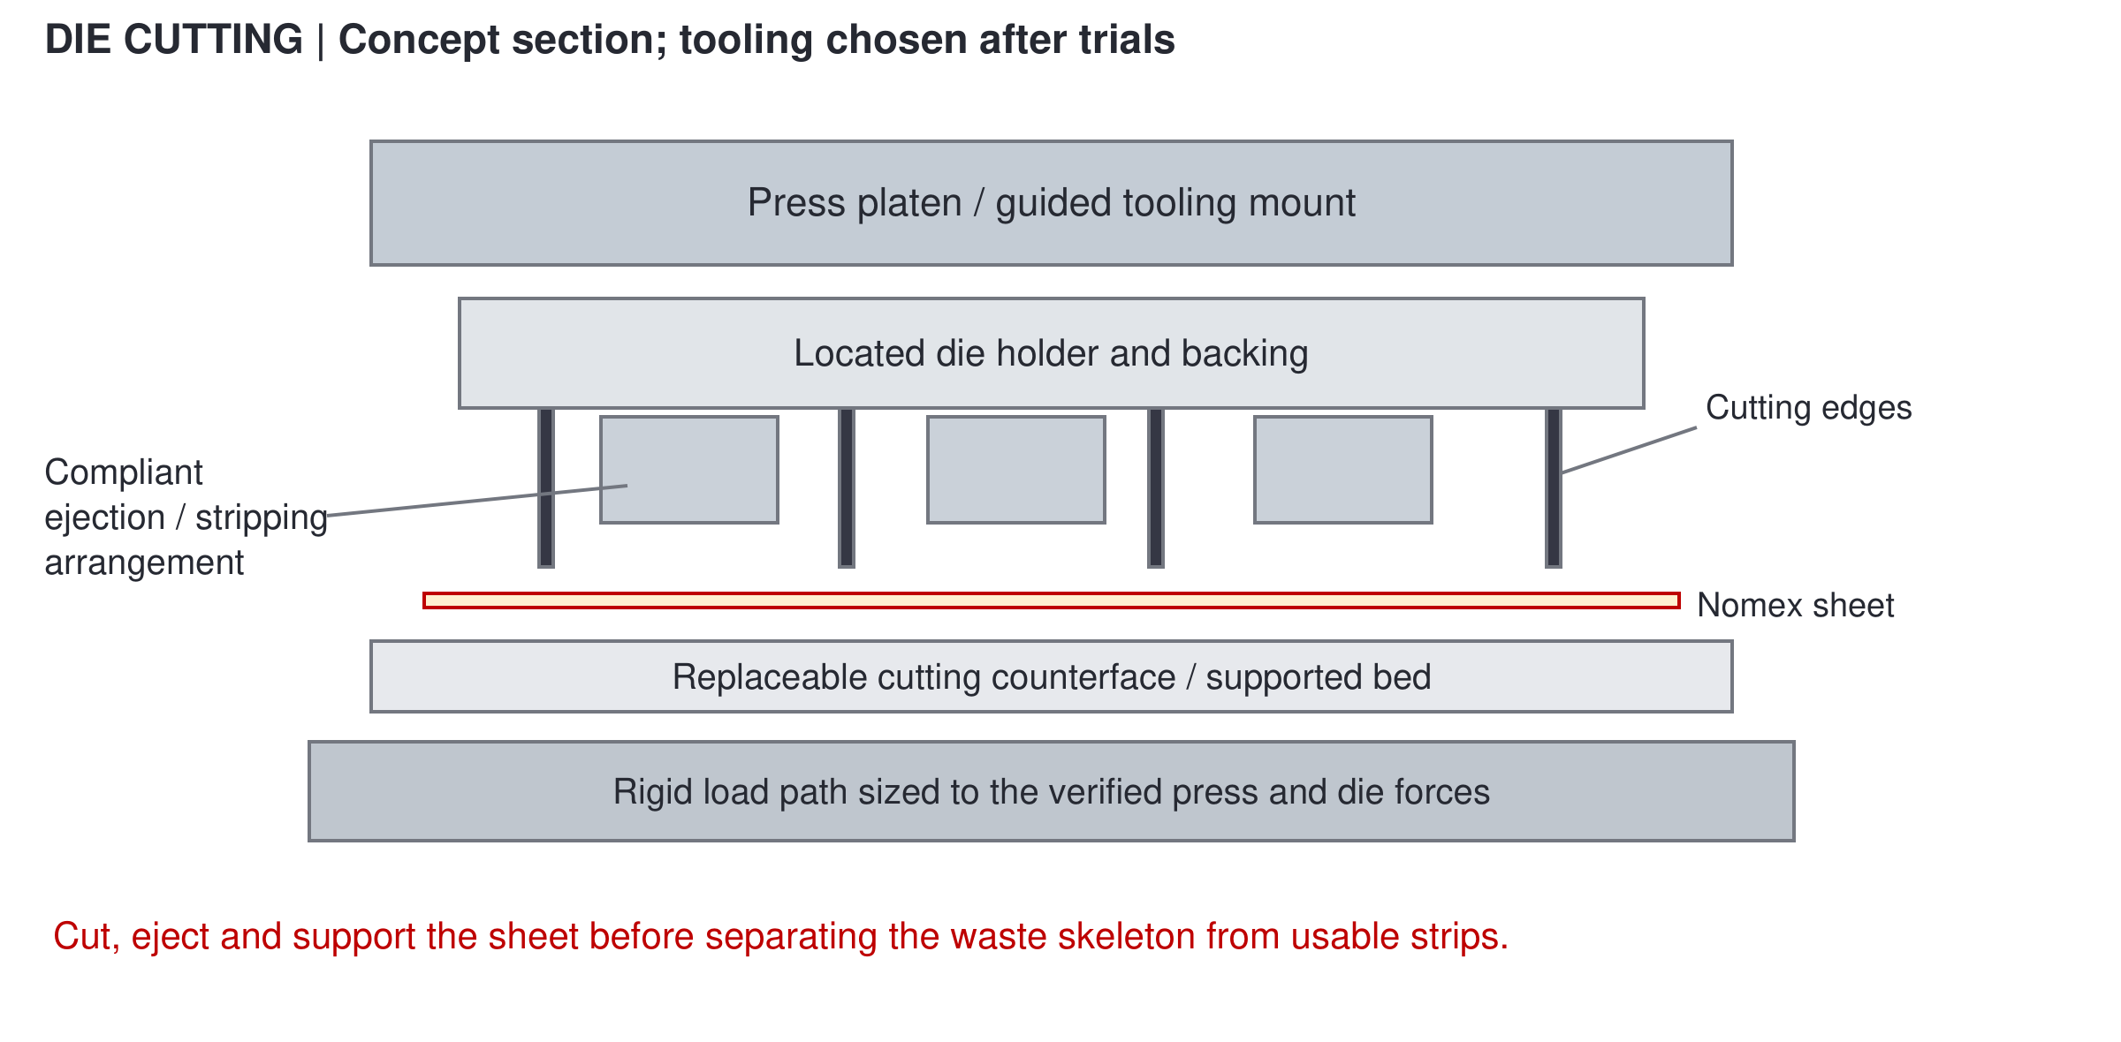
AETEC / DSO NATIONAL LABORATORIES
Upstream die-cutting POC
Q912226011A
SGD 168,000
10–14 weeks after inputs and trial-press confirmation
Sheet handling and trial tooling
Single-sheet separation and registration. One coupon die plus one nominal full-width die.
Cut, release and transfer
Evaluate cut quality, waste separation, strip orientation, vision and handoff to a mock loading datum.
Existing concept section. Final tooling follows material trials.
Measured development campaign
What management receives
180 coupon strokes, 30 full-width cutting attempts, 60 transfers and up to 2 combined refinements.
Trial dies and records, loading-interface definition, feasibility report and a production recommendation.
Preliminary scope: confirm sheet format and cutting drawings. Production press and automatic line excluded.
Management review • 19 October 2026 • Budgetary prices exclude GST
03
Notes:
Source: Q912226011A PDF pp.3–8. Uses a safeguarded laboratory/subcontract press; its use is included but purchase/transfer is excluded. One grade/thickness, one A/B strip family, one sheet format. 200 feed/register attempts,180 coupon strokes,30 nominal1m cut attempts,100 waste handling,100 image cases,30 measurements,60 transfers,20 controlled recovery cases; campaign totals include repeats. Existing press retrofit, roll feed, extra dies/formats/iterations and production supply are excluded and separately scoped if requested. Initial coupon and full-width dies may share tooling. Sources for figure: Q912226011A_Die_Cutting_POC_Technical_Proposal.docx, embedded concept section.

Slide 4
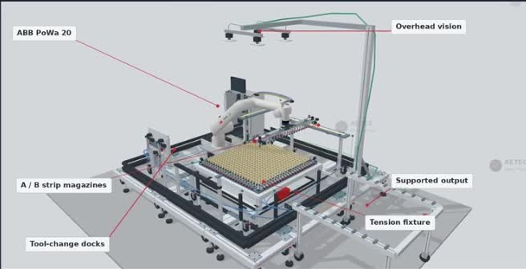
AETEC / DSO NATIONAL LABORATORIES
Complete honeycomb assembly system
Q912226009J / Revision J
SGD 936,000
40–48 weeks, including the initial POC
Flexible-paper assembly cell
ABB PoWa 20, supported gripper, spring-tension fixture and modular aluminium-profile construction.
Inspection and both adhesive modes
Camera alignment and grid / height checks. Drip and spray included, with automatic spray covers.
Nominal 1,000 × 1,000 mm core. 50 mm reference geometry.
Controls, build and handover
Budget allocation
Robot / PLC / local PC software, engineering drawings, FAT, Singapore installation, SAT and training.
R&D and engineering 526k
Hardware / fabrication 360k
Assembly, validation and delivery 50k
Extra-priced options: production platen / vibration. Upstream cutting and transfer are separate supply.
Management review • 19 October 2026 • Budgetary prices exclude GST
04
Notes:
Source: Q912226009J PDF pp.3–10. Total526,000+360,000+50,000=936,000, excludingGST. Full-project budget already contains defined R&D/POC work and both adhesive modes. Recipes are alternatives, not consecutive requirements. Manual magazine replenishment and operator-assisted supported unloading are the base. Single-component non-hazardous ambient-cure adhesive basis. Production platen/vibration manufacture, actuation, load controls and qualification are optional, without a quoted fixed option price. Product geometry, performance, loads, reach, safeguarding and module transport sizes require approval/verification. POC price is not automatically deducted in full or added to this total. Image: supplied reference video at00:44. Concept geometry, not a manufacturing release.

Slide 5
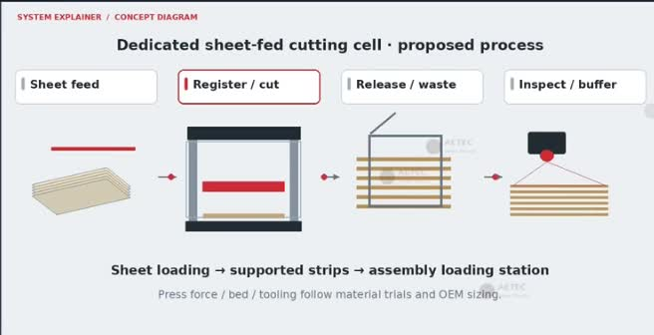
AETEC / DSO NATIONAL LABORATORIES
Complete upstream cutting and loading system
Q912226012A
SGD 450,000
32–40 weeks, including the initial POC
Raw sheets to inspected strips
New guarded cutting station, sheet magazine, registration, production tooling and waste release.
Direct assembly-loading interface
Supported A/B strip transfer, output buffer, vision and controller handshakes with the assembly station.
Proposed sheet-fed process. Press / die sizing follows trials.
Controls, build and handover
Budget allocation
Modular frames, safeguards, PLC / operator interface, drawings, FAT, Singapore installation, SAT and training.
Equipment and tooling 348k
Development / design / software 65k
Integration and handover 37k
Separate scope: assembly machine. Roll feed, extra formats and existing-press retrofit require new pricing.
Management review • 19 October 2026 • Budgetary prices exclude GST
05
Notes:
Source: Q912226012A PDF pp.3–8. Equipment/tooling grouped M01–M07:90+62+45+48+35+44+24=348k. M08=65k, M09=37k, total450k excludingGST. New dedicated press is the basis. Includes incremental transfer hardware and agreed handshakes at both ends to the AETEC assembly station. Manual sheet replenishment and waste-bin emptying. Complete upstream budget includes defined development. Final press capacity, bed size, die arrangement and actuation follow trial results and supplier confirmation. Existing-press retrofit, roll unwinding/splicing, additional materials/formats, enterpriseIT and external qualification are excluded and separately scoped if requested. Quotation terms govern. Image: supplied reference video at07:00.

